Slide 1
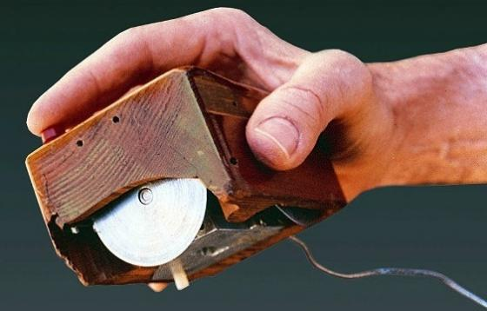
Scenarios, Input + Output CSCI 5839 Fall 2014 Shaun Kane
Notes:
http://searchengineland.com/figz/wp-content/seloads/2014/01/personas.jpg

Slide 2
Today
Finishing personas
Scenarios
Things to think about re: input and output
Reminder: BTU Open House Today 6-8pm, ENVD 234

Slide 3
Assignments etc.
Due today
Assignment 1: observation
Due in one week: Team Project 1
Formative research
2 methods
At least 4 potential users
Research report
5-minute progress report/summary
Don’t be afraid to ask for feedback
Notes:
Open ended is part of the class, graduate class. So if you want feedback don’t hesitate to ask me or TAs

Slide 4
Personas redux
5 minutes: Come up with 5 attributes describing your users
5 minutes: Write one interesting persona describing a potential user (1-2 paragraphs)
We’ll post them on Piazza

Slide 5
Maya
Shari
Lucy
Randy
“Leif Blouwer”
Peter Simpson
Jen

Slide 6
What to do with personas?
Hang them up
Bring them to meetings
Discuss them with clients
Write scenarios about them

Slide 7
Users vs. stakeholders (or primary vs. secondary users)
Remember that the primary user is often not the only person who interacts with a computing system
Consider a new electronic door lock system for CU dorms
Who is the primary user?
Who else might interact with the system?

Slide 8
Further reading on personas
Pruitt, J., & Grudin, J. (2003, June). Personas: practice and theory. In Proceedings of the 2003 conference on Designing for user experiences (pp. 1-15). ACM. http://ued.taobao.org/blog/wp-content/uploads/2006/10/Personas%20practice%20and%20theory.pdf

Slide 9
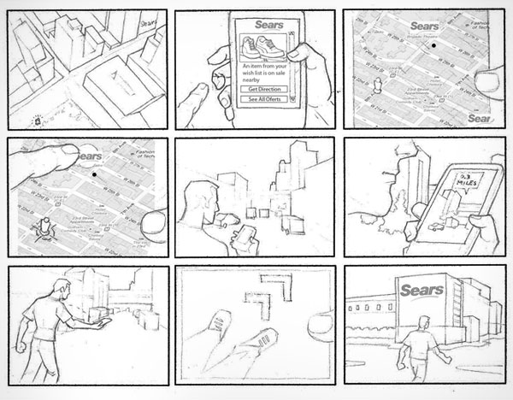
Scenarios
Notes:
http://www.fabiangarzon.com/Images/mobile_deals/storyboard/storyboard_1.jpg

Slide 10
Scenarios
We already generated tasks (through task analysis, brainstorming, competitive analysis)
But:
Tasks not very rich
Do not capture the context of use
Boring

Slide 11
Scenarios
Very short stories describing how a user (represented by a persona) performs a task using technology
Should capture
The goal / problem
Context (environment, activities)
Technology used
Steps taken
Whether they are successful

Slide 12
Example scenario
Sal awakens: she smells coffee. A few minutes ago her alarm clock, alerted by her restless rolling before waking, had quietly asked "coffee?", and she had mumbled "yes." "Yes" and "no" are the only words it knows.
Sal looks out her windows at her neighborhood. Sunlight and a fence are visible through one, but through others she sees electronic trails that have been kept for her of neighbors coming and going during the early morning. Privacy conventions and practical data rates prevent displaying video footage, but time markers and electronic tracks on the neighborhood map let Sal feel cozy in her street.
Glancing at the windows to her kids' rooms she can see that they got up 15 and 20 minutes ago and are already in the kitchen. Noticing that she is up, they start making more noise.
At breakfast Sal reads the news. She still prefers the paper form, as do most people. She spots an interesting quote from a columnist in the business section. She wipes her pen over the newspaper's name, date, section, and page number and then circles the quote. The pen sends a message to the paper, which transmits the quote to her office.
Weiser, M. (1991). The computer for the 21st century. Scientific American, 265(3), 94-104. http://wiki.daimi.au.dk/pca/_files/weiser-orig.pdf

Slide 13
Further reading: scenarios
Jeff Sauro, Measuring Usability. Seven Tips for Writing Usability Task Scenarios. http://www.measuringusability.com/blog/task-tips.php
Bødker, S. (2000). Scenarios in user-centred design—setting the stage for reflection and action. Interacting with computers, 13(1), 61-75. http://potoulis.edc.uoc.gr/application/scenarios_in_user-center.pdf

Slide 14
Targeted vs. non-targeted use
Users will not always use technology for intended tasks
Use cell phone camera as flashlight, mirror (to check teeth), periscope
Some use technology for nefarious purposes

Slide 15
What to do about non-targeted use?
May decide to support it
Many flashlight apps
May decide to block it
Either way, useful to understand it

Slide 16
Extending the model
Pastiche scenarios. Mark A. Blythe and Peter C. Wright. 2006. Pastiche scenarios: Fiction as a resource for user centred design. Interact. Comput. 18, 5 (September 2006), 1139-1164. http://markblythe.me.uk/MarkBlythe/Journals_files/Pastiche%20Scenarios.pdf
Value scenarios/design noir. Lisa P. Nathan, Batya Friedman, Predrag Klasnja, Shaun K. Kane, and Jessica K. Miller. 2008. Envisioning systemic effects on persons and society throughout interactive system design. In DIS '08. ACM, New York, NY, USA, 1-10. http://dl.acm.org/citation.cfm?id=1241046

Slide 17
Let’s try it
Write two scenarios for your project work
Before your system
Using your system
http://www.youtube.com/watch?v=3eMCURWpNAg

Slide 18
One possibility
Sentence 1: Persona and goal
Sentence 2: what they try
Sentence 3: what is the problem? Can they avoid the problem?
Sentence 4: Happy/sad ending

Slide 19
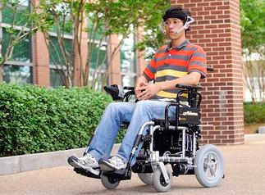
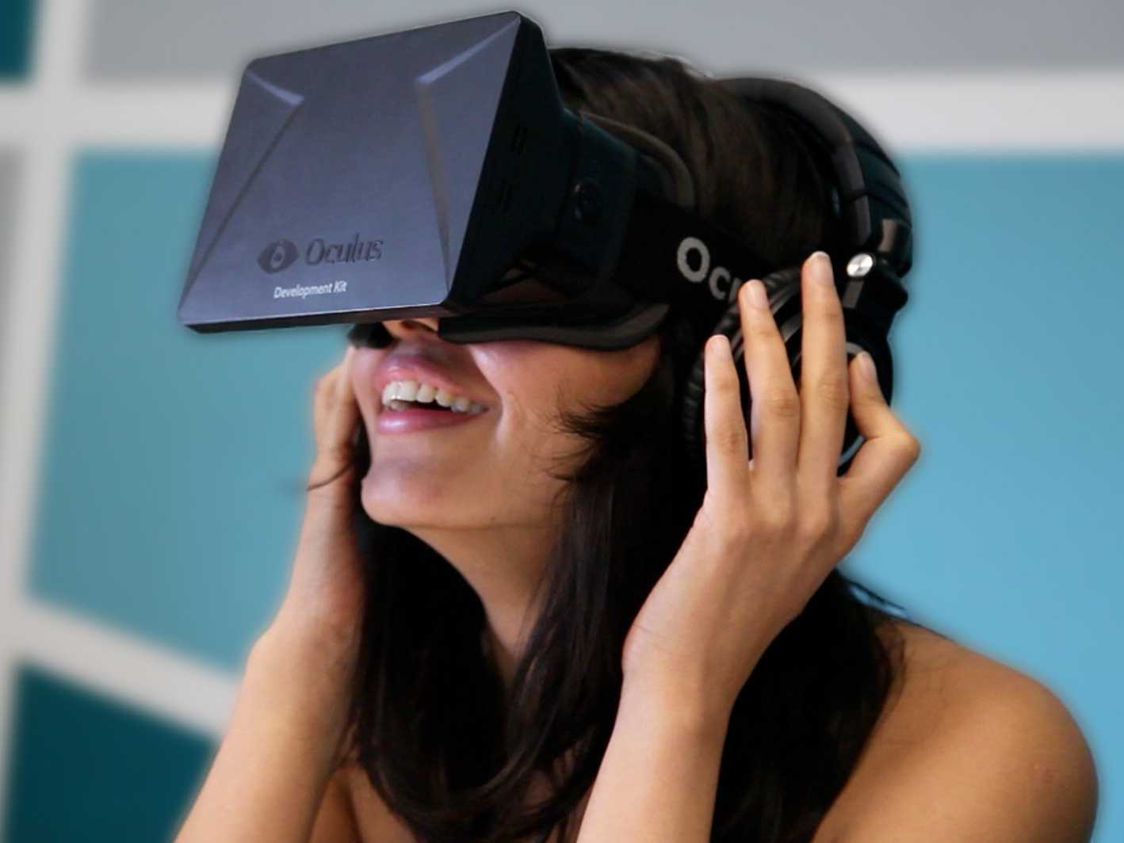
Finally
A brief introduction to input/output
Notes:
Tongue input, http://inputandoutputdevices.wikispaces.com/file/view/tongue-device.jpg/113010739/323x238/tongue-device.jpg
Oculus rift http://static3.businessinsider.com/image/51d1949aecad04ad3e000000/heres-what-happened-when-we-strapped-a-bunch-of-people-into-the-oculus-rift-virtual-reality-headset.jpg

Slide 20
I/O is complicated!
I previously taught a semester-long course on input and output (happy to share the slides)
For this class, understand what is convention (and identify opportunities to improve it)

Slide 21
Input and output on mobile devices

Slide 22
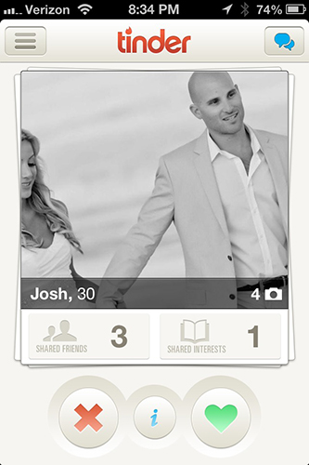
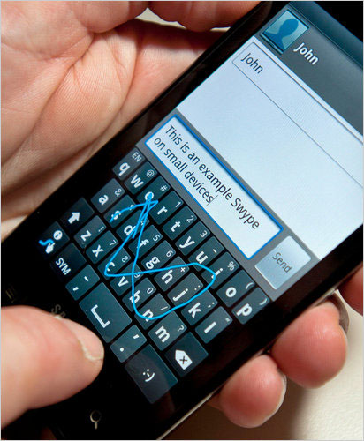
“Traditional” types of input
Text entry
Pointing / selection
Notes:
Swype, http://9to5google.files.wordpress.com/2011/10/swype-100621.jpg
Tinder, http://s3.r29static.com/bin/entry/69a/x/1075078/image.jpg

Slide 23
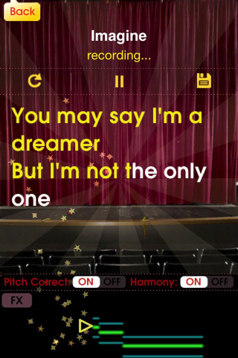
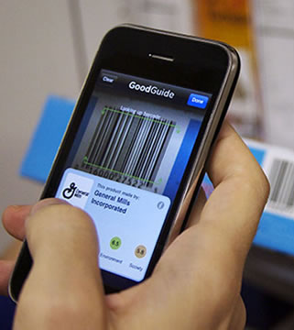
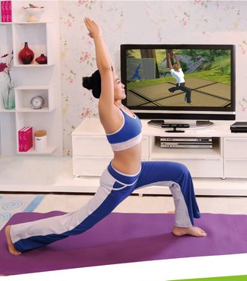
Other forms of input
Voice
Images / video
Movement
Notes:
Glee Karaoke, http://inventorspot.com/files/images/Glee_-_1.img_assist_custom.jpg
Barcode scanner, http://contentinjection.com/wp-content/uploads/2014/03/reliable-barcode-scanner-app.jpg
Yoga Klinect app, http://gadgetizor.com/wp-content/uploads/2012/04/ct51.jpg

Slide 24
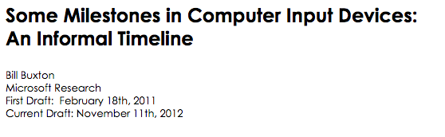
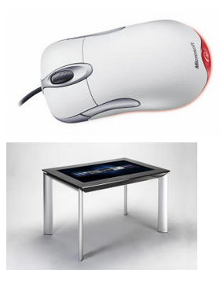
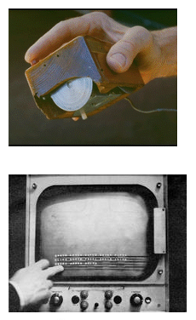
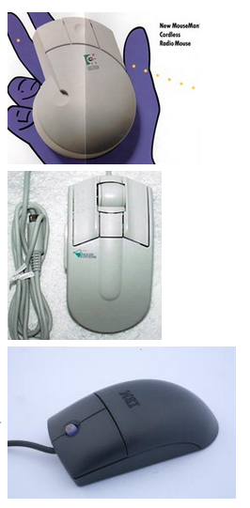
Notes:
http://www.billbuxton.com/inputTimeline.html Thanks, Jennings!

Slide 25
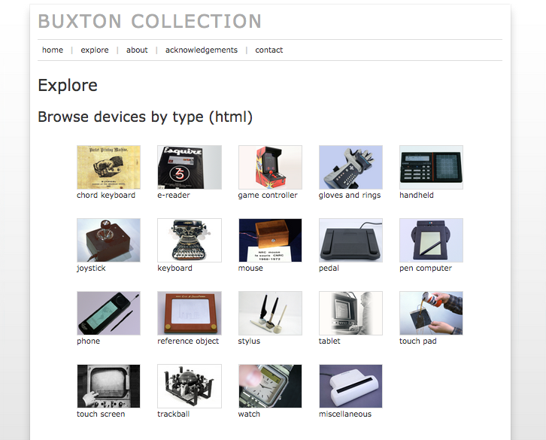
Notes:
http://research.microsoft.com/en-us/um/people/bibuxton/buxtoncollection/browse.aspx
Thanks to Jennings

Slide 26
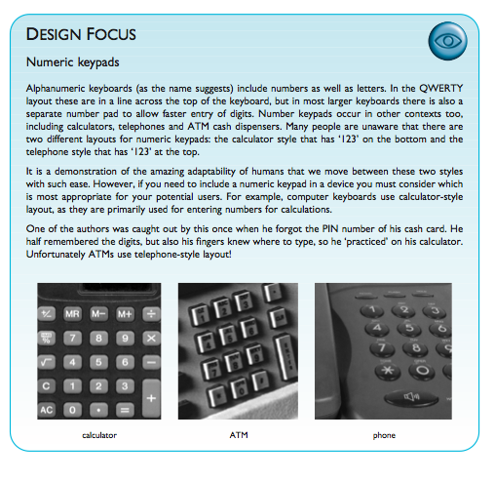
Change is fast

Slide 27
6 Thoughts on Input/Output
Consider environment
Remember human limitations
“Intuitive” usually isn’t
Reduce input complexity
Leverage past behavior
Leverage contextual information

Slide 28
1. Consider the environment
What do we know about the possible environments of use?
Notes:
Weather? Movement? Ambient noise?

Slide 29
1b. Use while moving
Negatively affects
Reading ability
Reading speed
Pointing ability
Users may be “situationally impaired”
Sears, A., & Young, M. (2002, January). Physical disabilities and computing technologies: an analysis of impairments. In The human-computer interaction handbook (pp. 482-503). L. Erlbaum Associates Inc..

Slide 30
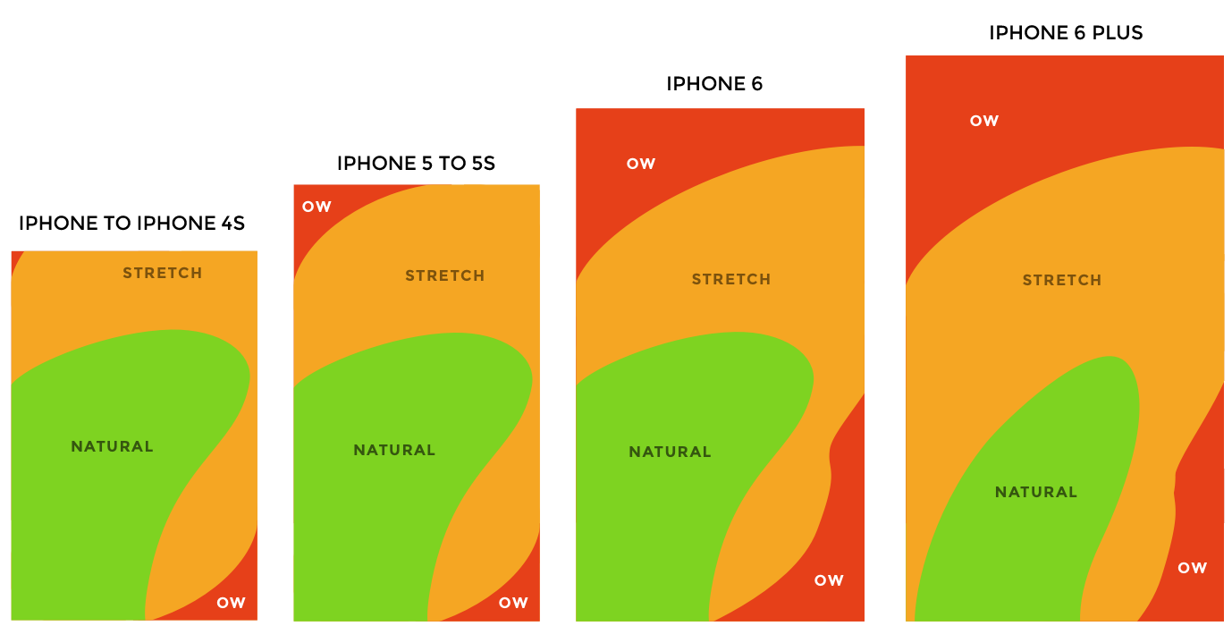
2. Remember human limitations
Reach, size, memory, vision, parallel processing…
(remember back to The Human)
Notes:
http://img.qz.com/2014/09/thumb-zones-lineup.png

Slide 31


3. Intuitive usually isn’t
A lot of what we think of as “intuitive” or natural is learned
Gestures
Sounds
UI conventions
Notes:
gesture, http://upload.wikimedia.org/wikipedia/commons/c/cc/Pinch_zoom.png
Hamburger menu, http://www.attacat.co.uk/wp-content/uploads/burger1.png

Slide 32
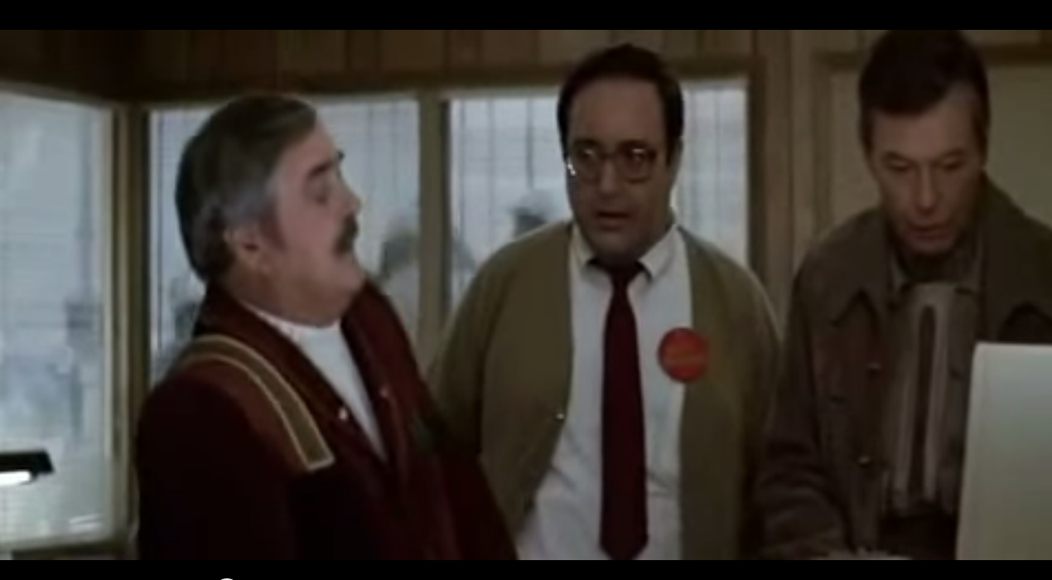
http://www.youtube.com/watch?v=hShY6xZWVGE

Slide 33
Input is difficult
Especially while mobile
So…

Slide 34
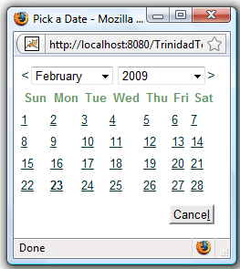
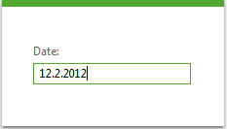
4. Reduce input complexity
Notes:
http://www.telerik.com/sfimages/default-sohttp://www.jsftoolbox.com/images/trinidad/trinidad-tr-inputDate.gifurce/productsimages/asp.net-ajax/productitemfeatures/input_raddateinput_screenshot-png.png?sfvrsn=0
Reduce number of clicks AND reduce error
Can we simplify this further? What if we are making an airline reservation app?

Slide 35
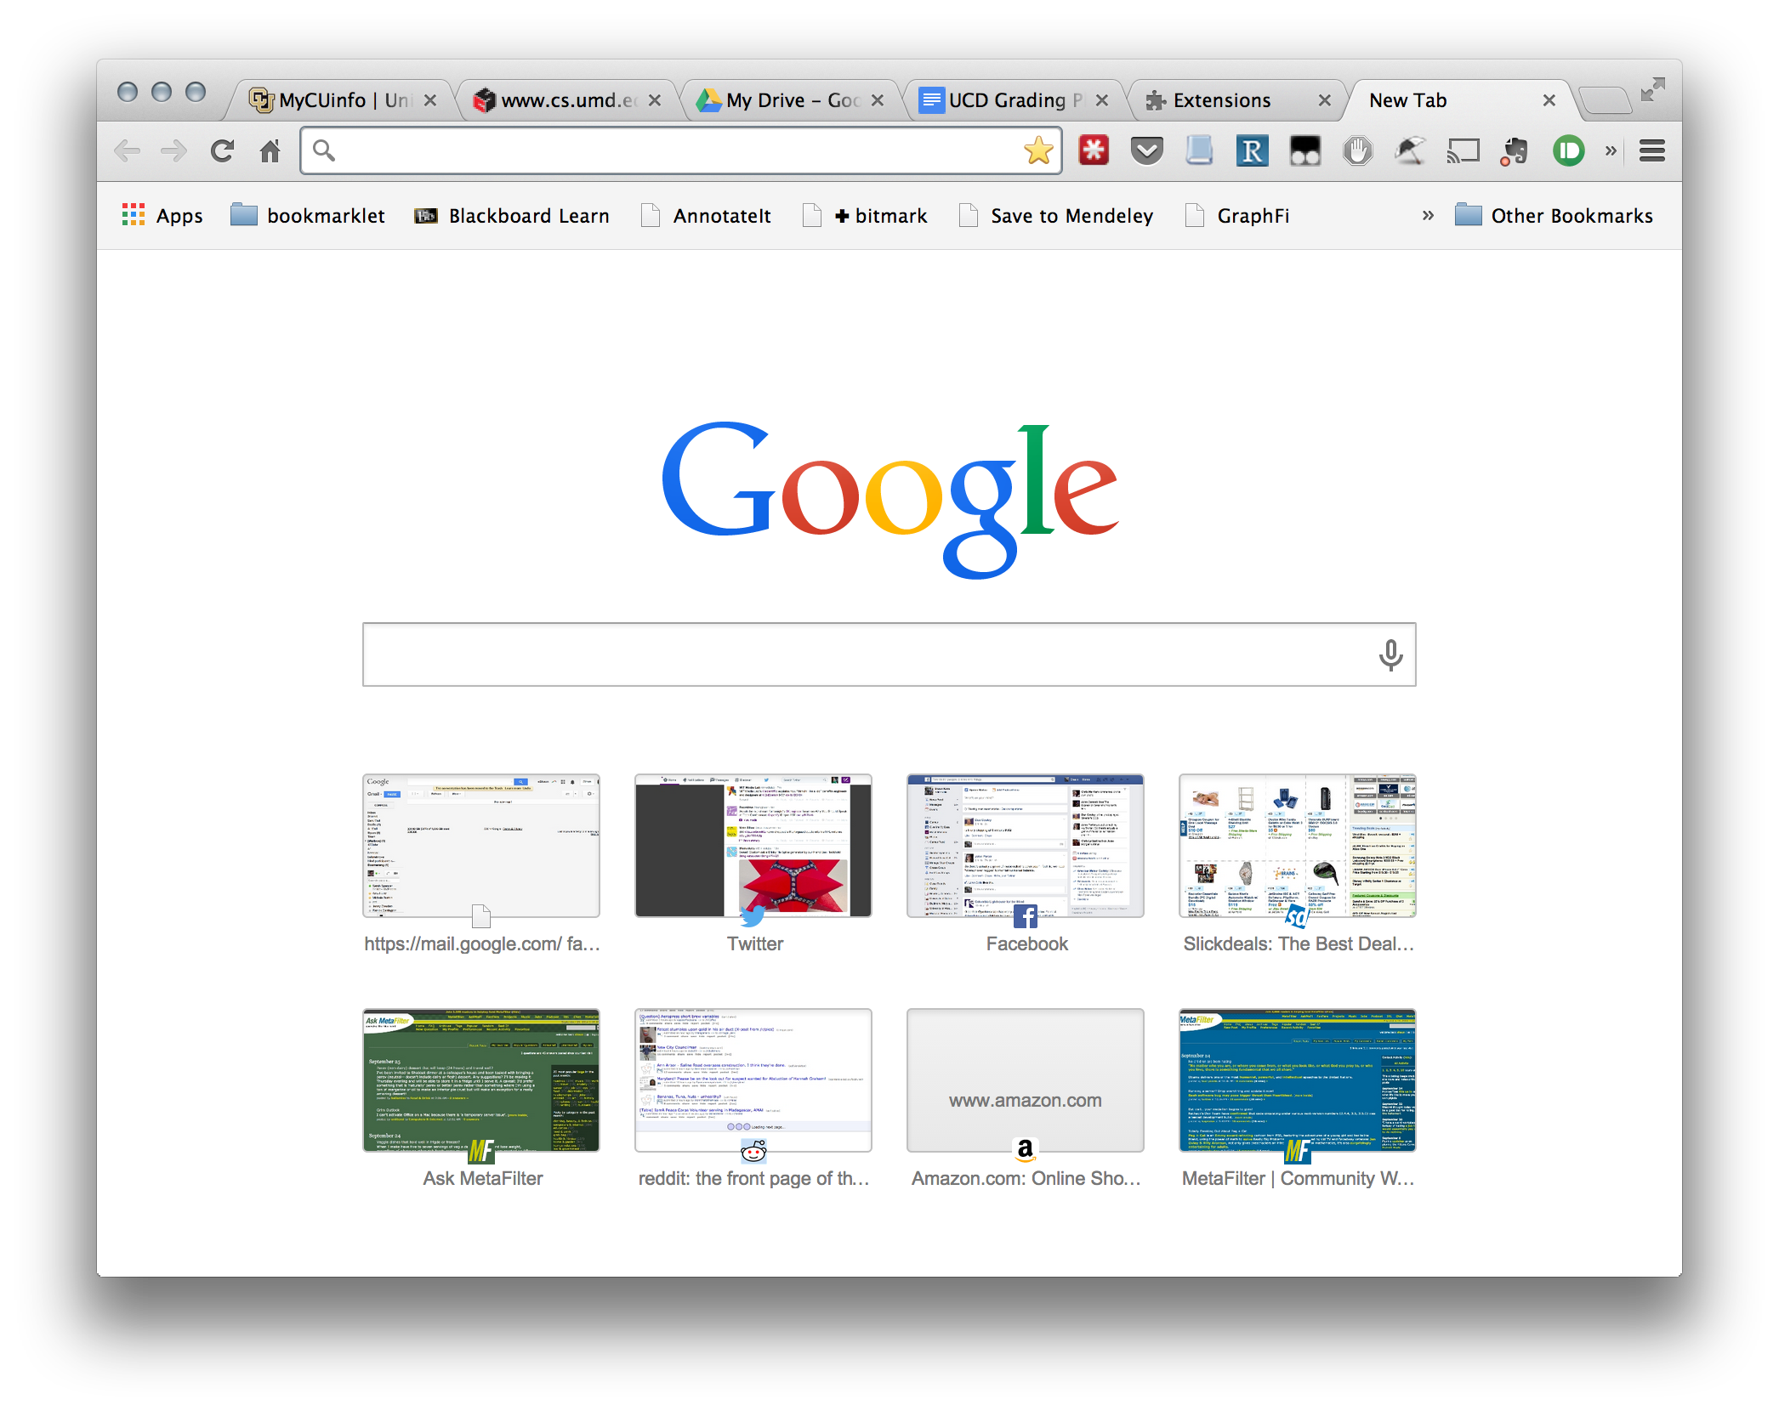
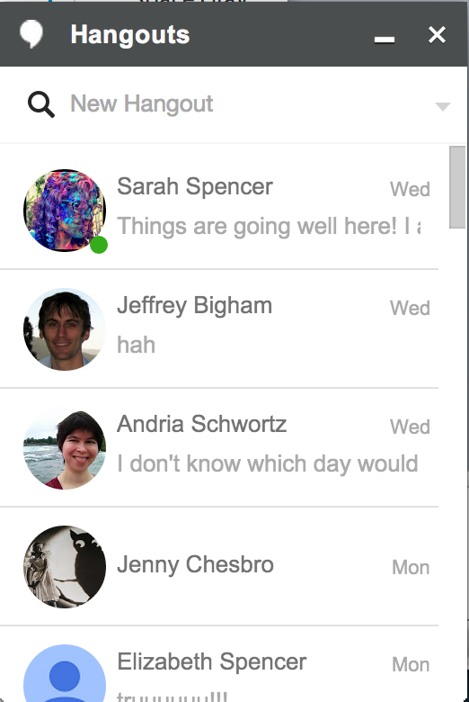
5. Leverage past behavior
Best predictor of future behavior
Notes:
Google

Slide 36
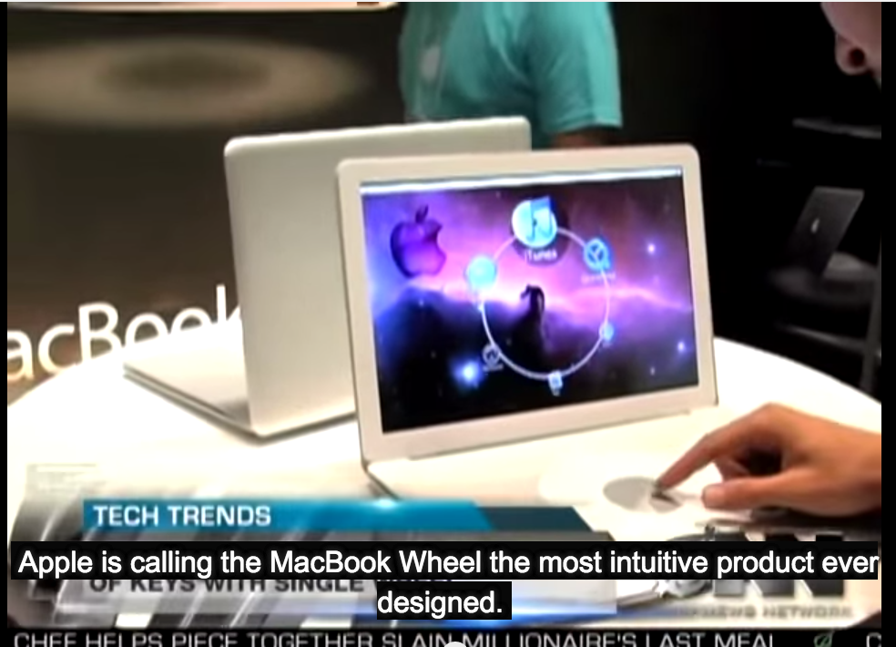
http://www.youtube.com/watch?v=9BnLbv6QYcA

Slide 37
6. Leverage context
What do our devices know about our situation? How can this help?

Slide 38
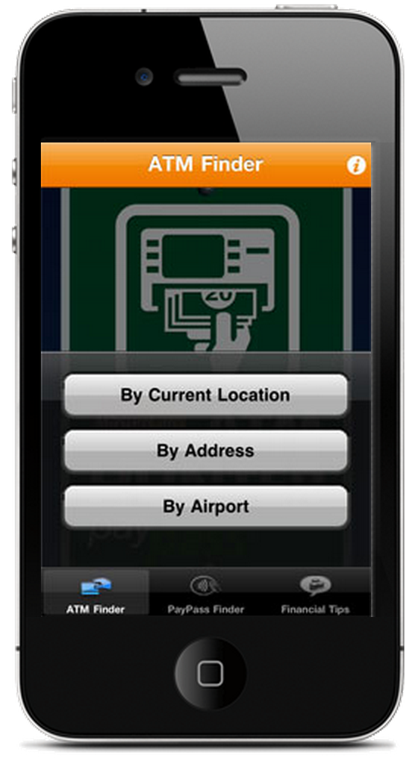
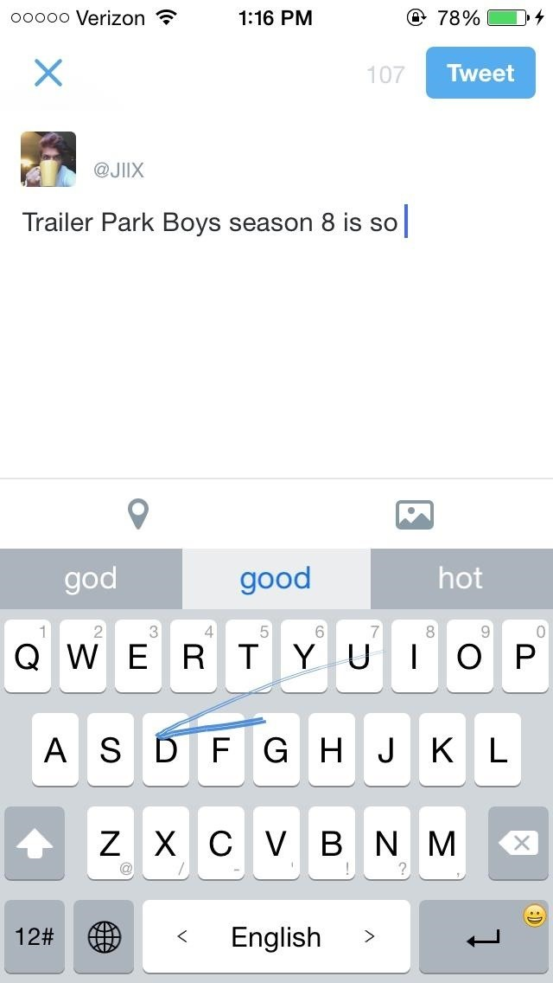
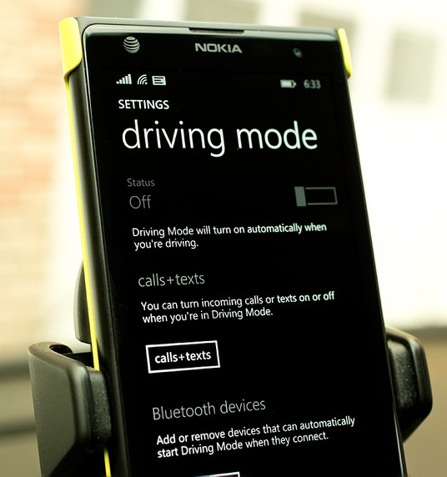
Notes:
MasterCard ATM hunter http://www.mastercard.us/small-business/mobile/atm-hunter.html
http://www.wpcentral.com/sites/wpcentral.com/files/styles/large_wm_blw/public/field/image/2014/04/Drive_Mode.jpg?itok=EEfziraX
Iphone keyboard http://img.wonderhowto.com/img/87/34/63546643204426/0/6-best-third-party-keyboards-available-right-now-for-ios-8.w654.jpg

Slide 39
Let’s try it
Consider your project
What is the “obvious” way to input data?
What is a different way?

